Slide 1
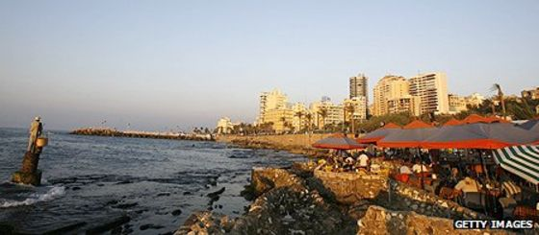
By: Jason Reynolds
7th Grade
Mr. Riddick
Lebanon
)لبنان(
(Arabic)

Slide 2
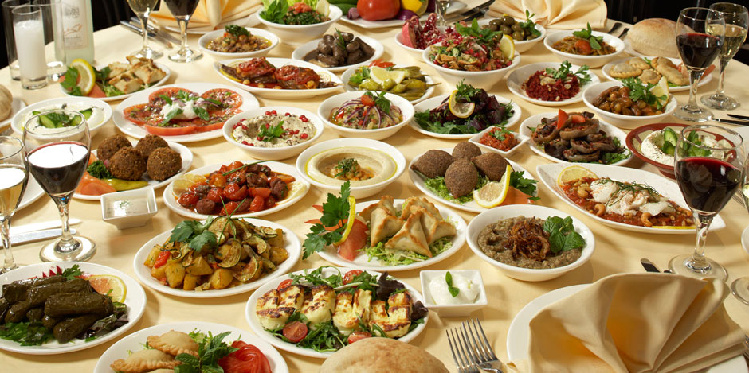
Food
)طعام(
Lebanon has lots of traditional foods just like Americans.¹Lebanon’s most famous foods are goat, lamb, and cow meat. ²Some of their traditional dishes are Meghli and Mezze, which are both used in celebrations.

Slide 3
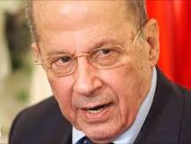
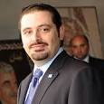
Government
)حكومة(
The government may be the most important topic today in any country, but especially Lebanon, since it is surrounded by terrorists and violence.³Lebanon is a Parliamentary Democratic Republic, which means it is a mix of a couple of governments. ⁴Michel Aoun is the current president of Lebanon (left), ⁵and Saad Hariri is the current Prime Minister (right).

Slide 4
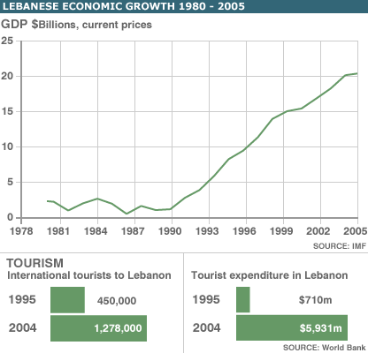
Economy
)اقتصاد(
A country’s economy plays a key role in its people’s prosperity.⁶Lebanon is a developing free market economy. It was greatly affected by the Syrian Civil War since Syria is a big trading partner with Lebanon. ⁷Some of the major industrial sectors are metal, banking, agriculture, chemicals, and transport equipment. ⁸About 4.5 million people live in Lebanon ⁹and their unemployment rate is approximately 6.4%.

Slide 5
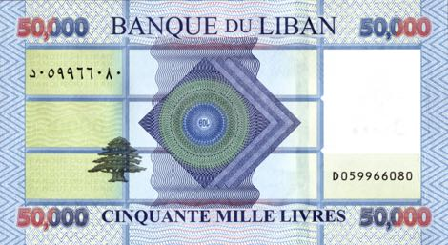
Money
)مال(
Lebanon has a rich history of currency based trade.¹⁰In Lebanon, the highest amount of money is the $50,000 bill. Just like many other countries, Lebanon uses the pound. ¹¹One Lebanese pound is equal to $.00066 US dollars. ¹²The first time a Lebanese pound was used, it was before the American Civil War, ¹³and it was also called an Ottoman Lira.

Slide 6
Conclusion
)استنتاج(
In conclusion I hope you enjoyed my presentation, and Thank You for listening.

